Slide 1
ESRGAN: Enhanced Super-Resolution Generative Adversarial Networks
Xintao Wang 1 , Ke Yu 1 , Shixiang Wu 2 , Jinjin Gu 3 , Yihao Liu 4 ,
Chao Dong 2 , Yu Qiao 2 , and Chen Change Loy
刘欣 1901210041

Slide 2
Introduction
Related Work
Proposed Methods
Experiments
Conclusion

Slide 3
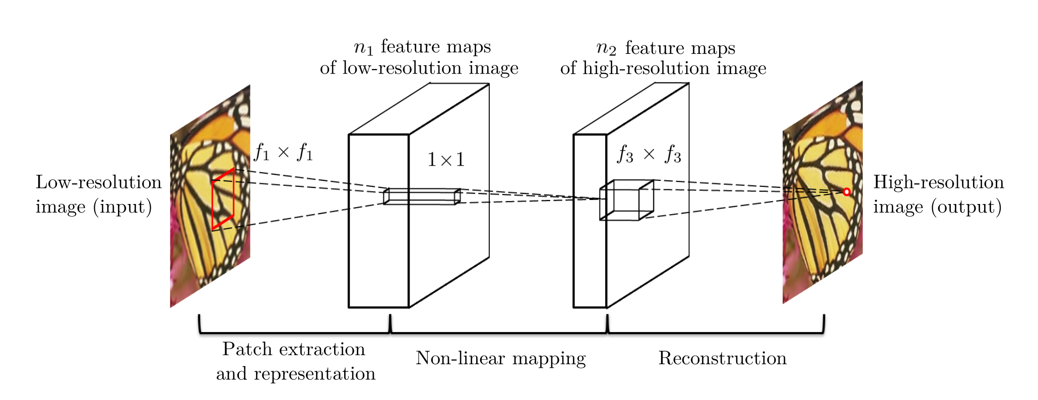
Related Work
SRCNN（CNN）

Slide 4
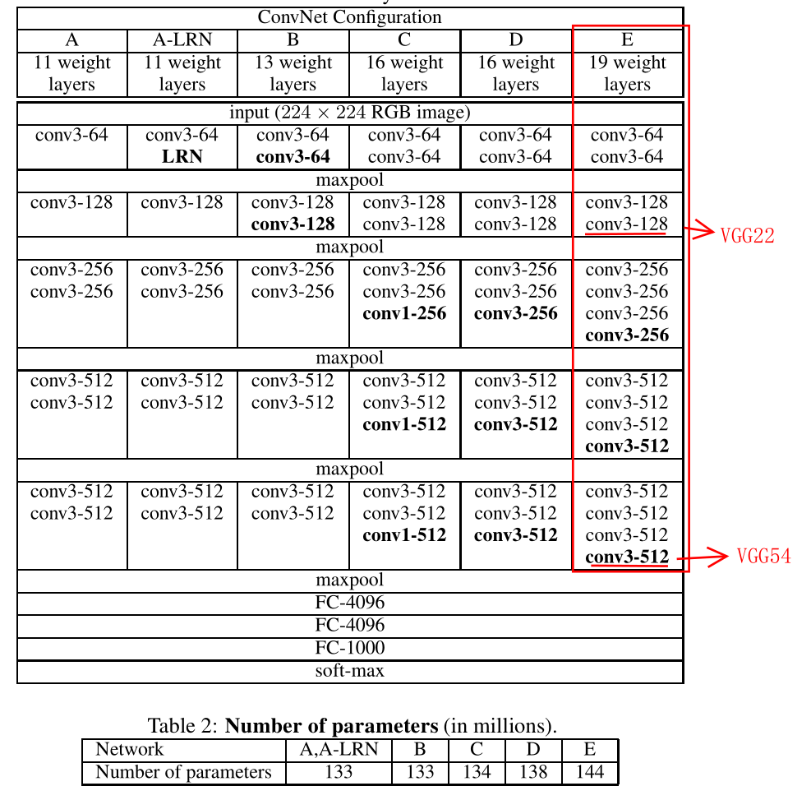
Related Work
VGG 19
VGG22: low level feature
VGG54: high level feature

Slide 5
Relates Work
SRGAN： GAN-based network
Distortion
pixel space loss
high PINR、overly smooth textures
Perceptual quality
Perceptual loss：feature space loss
Adversarial loss：pushes solution to the natural image manifold
realistic texture、 unpleasant artifacts

Slide 6
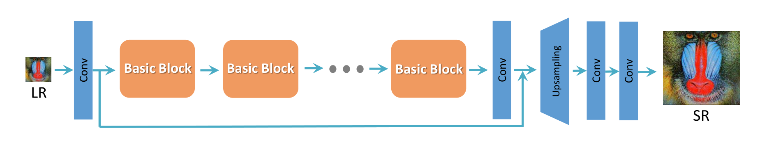
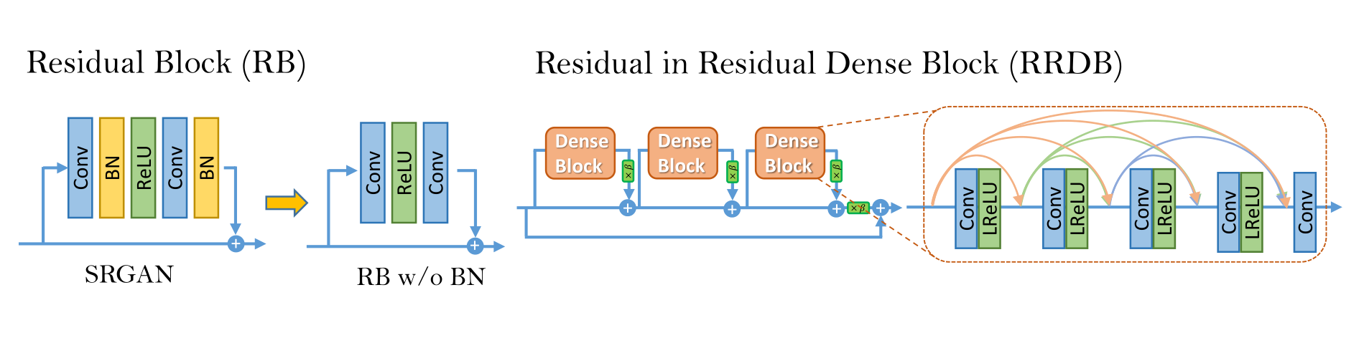
Proposed Methods(Network Architecture)

Slide 7
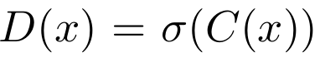
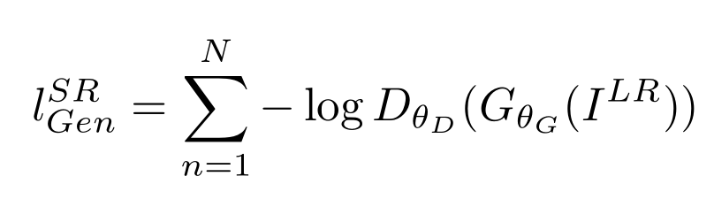
Proposed Methods(Relativistic Discriminator)
Standard Discriminator
Relativistic average Discriminator
Therefore, RaD benefits from the gradients from both generated data and real data in adversarial training, while in SRGAN only generated part takes effect.

Slide 8
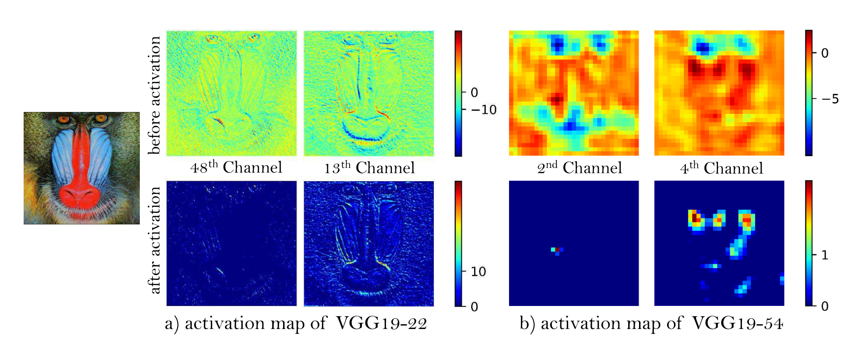
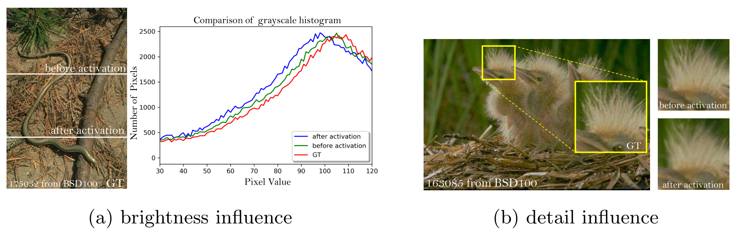
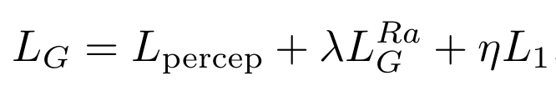
Proposed Methods(Perceptual Loss)
use features before the activation layers:
1) the activated features are very sparse, especially after a very deep network
2) using features after activation also causes inconsistent reconstructed brightness compared with the ground-truth image
The total loss for the generator:

Slide 9
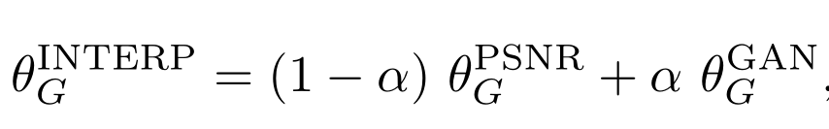
Proposed Methods(Network Interpolation)
First, the interpolated model is able to produce meaningful results for any feasible α without introducing artifacts.
Second, we can continuously balance perceptual quality and fidelity without re-training the model.

Slide 10
Experiments（Training Details）
with a scaling factor of ×4 between LR and HR images
First, train a PSNR-oriented model with the L1 loss.
Then, employ the trained PSNR-oriented model as an initialization for the generator.
For training data, mainly use the DIV2K dataset, which is a high-quality (2K resolution) dataset for image restoration tasks.

Slide 11
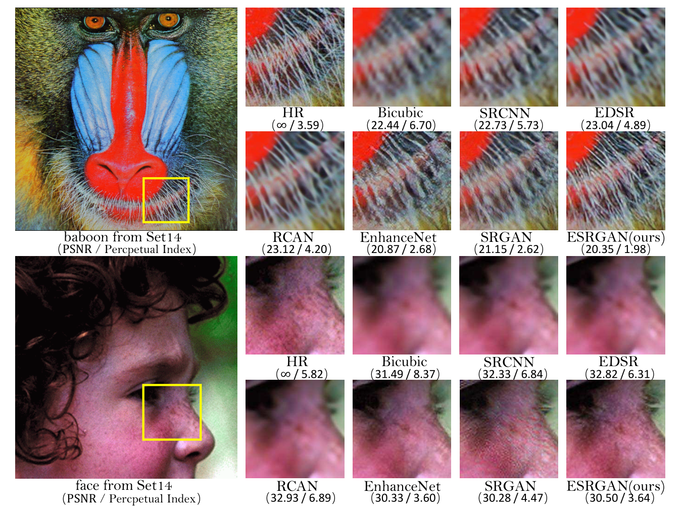
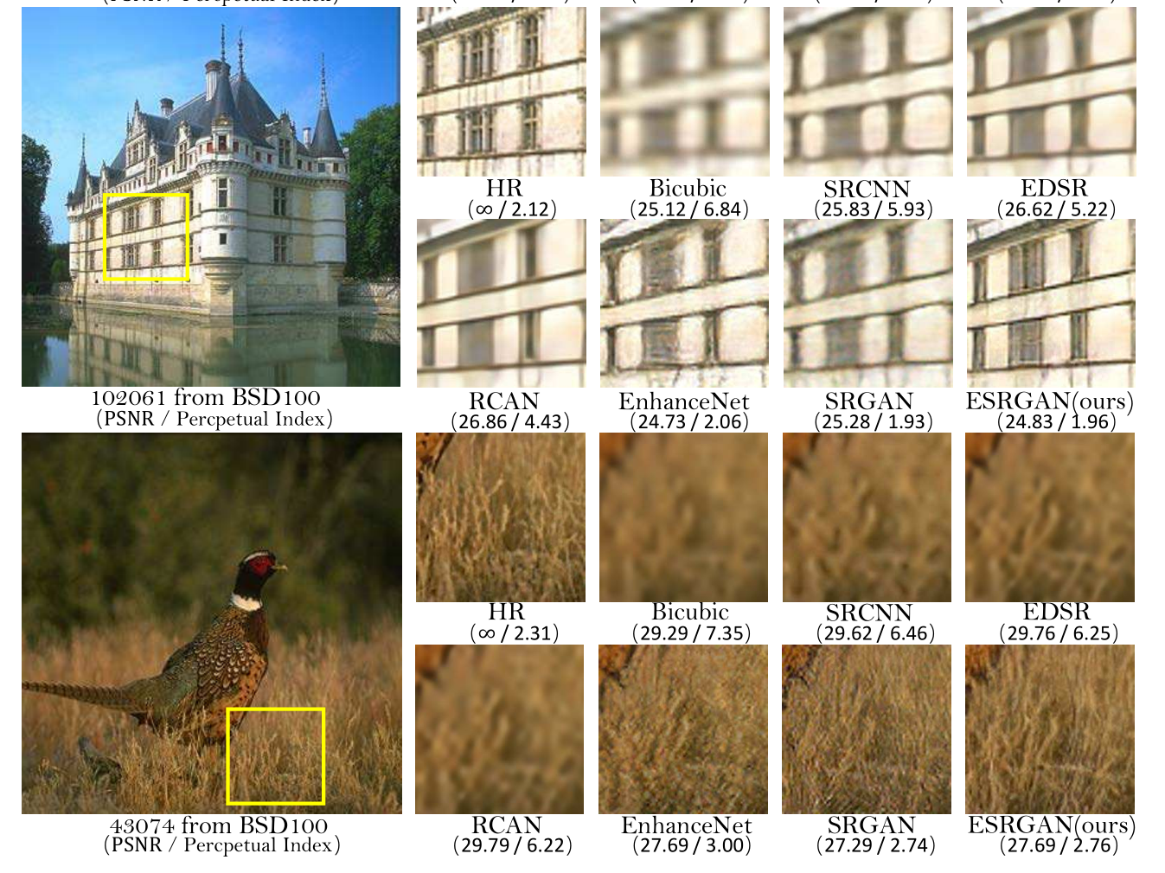
Experiments（Qualitative Results）

Slide 12
Experiments（Ablation Study）
BN removal：
1）Does not decrease the performance but saves the computational resources and memory usage.
2）The model with BN layers is more likely to introduce unpleasant artifacts.
Before activation in perceptual loss：
1）more accurate brightness distribution closer to that.
2）helps to produce sharper edges and richer textures of the ground-truth.
RaGAN：
benefit learning sharper edges and more detailed textures.
Deeper network with RRDB：
improve the recovered textures and reduce unpleasing noises

Slide 13
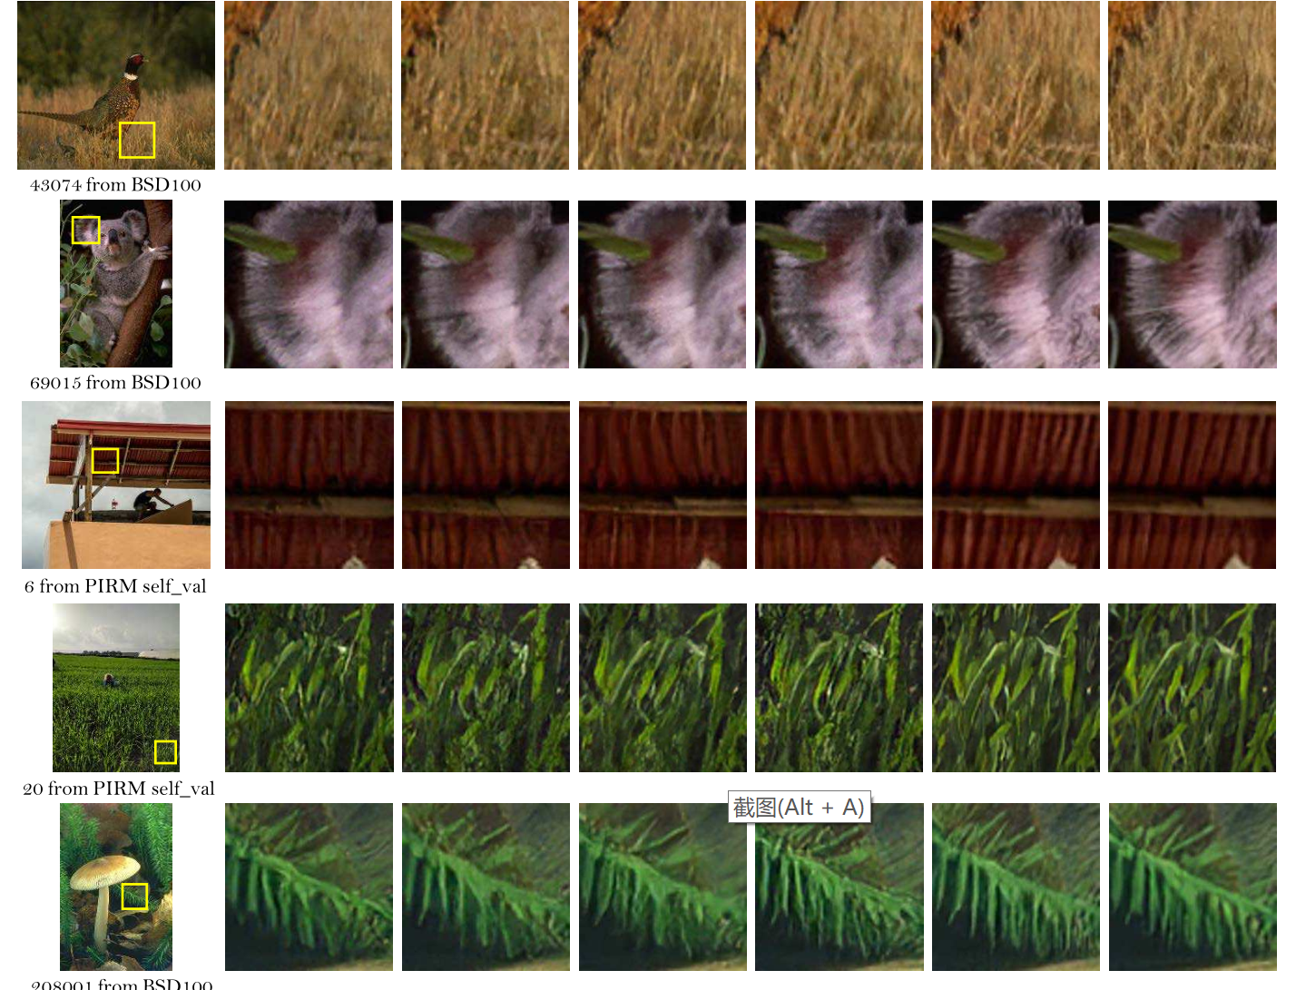
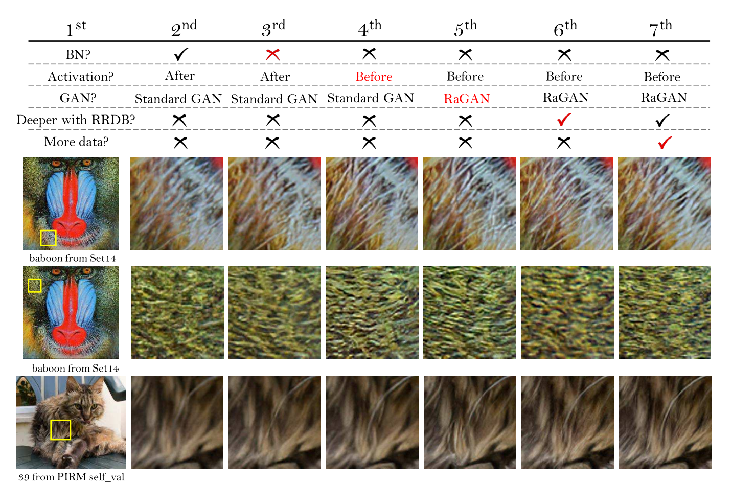
Experiments（Ablation Study）

Slide 14
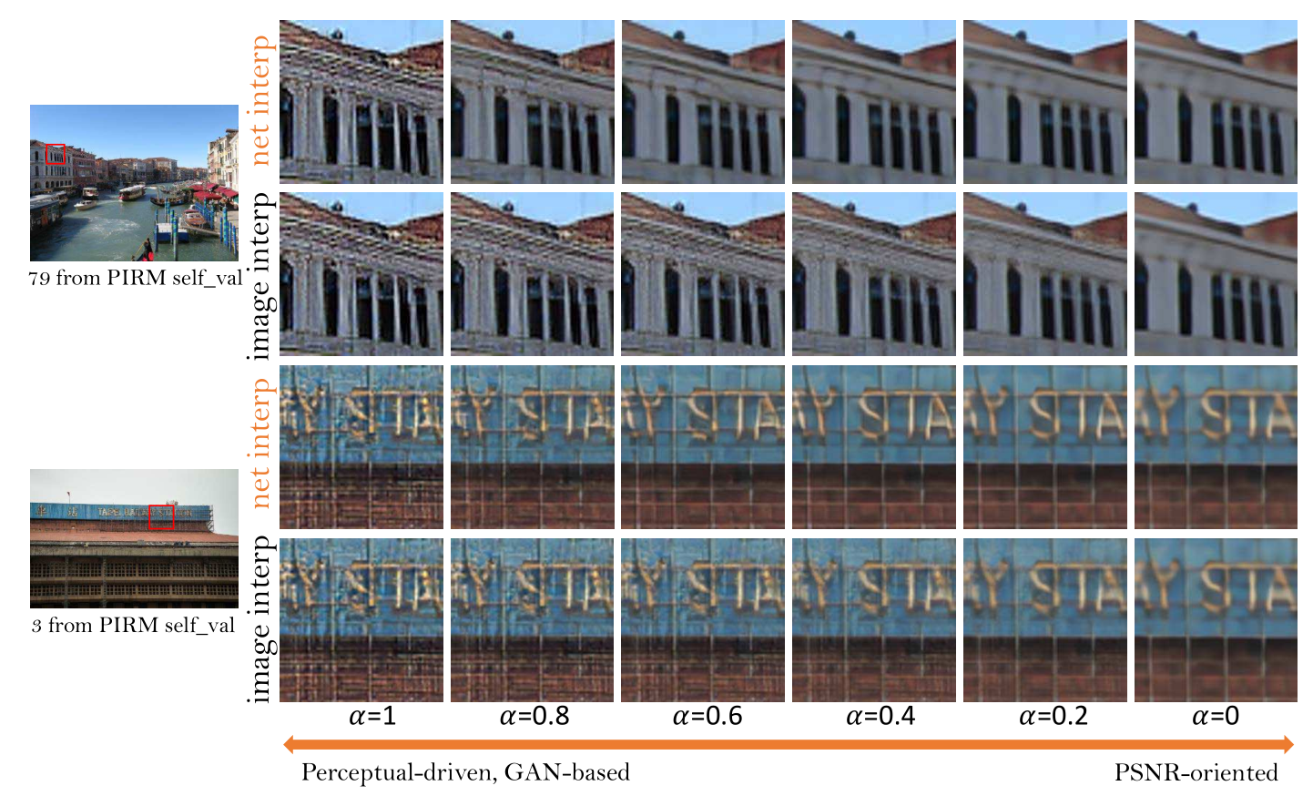
Experiments（Network Interpolation）
GAN-based method
PSNR-oriented method
network interpolation
image interpolation
sharp edges and
richer textures
unpleasant artifacts

Slide 15
Conclusion
Formulated a novel architecture containing several RDDB blocks without BN layers
Introduced the use of relativistic GAN as the discriminator
Enhanced the perceptual loss by using the features before activation

